Slide 1

Weeks 7–8: RNNs
When Order Matters — Sequences, Memory, and Time
IIT Madras · Wadhwani School of AI
Live Coding Session — Weeks 7 & 8

Slide 2
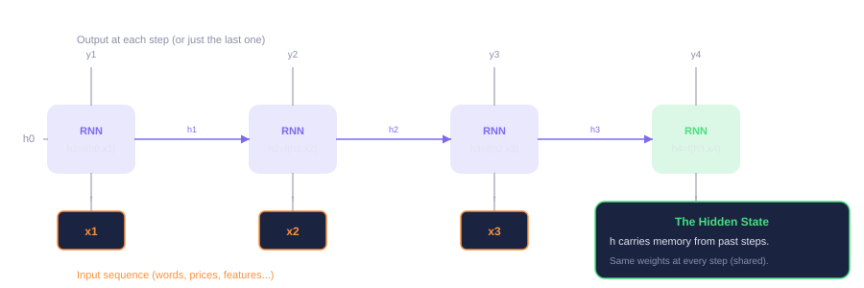
The RNN: A Network with Memory
Same weights at every step. The hidden state carries information forward.
In PyTorch: nn.RNN(input_size, hidden_size, num_layers) — one line. PyTorch handles the loop, hidden state init, and weight sharing.

Slide 3
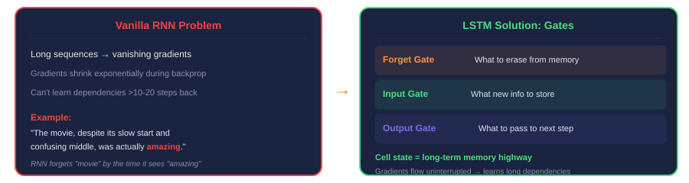
LSTM: Solving the Memory Problem
Gates control what to remember, what to forget, and what to output
In PyTorch: Just swap nn.RNN → nn.LSTM. Same interface, better memory.
When to use LSTM over RNN: Any time your sequences are longer than ~10–20 steps, or when long-range dependencies matter (most real-world tasks).
Same 5-step training loop. Same nn.Module. Same optimizer. The architecture handles the sequence processing internally.

Slide 4
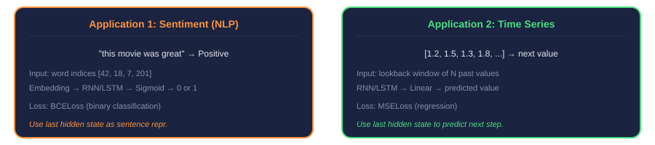
One Architecture, Two Domains
Same RNN/LSTM, different data — text vs numbers
What changes: Input representation (word embeddings vs raw numbers), loss function (BCE vs MSE), and which hidden state to use (last-step vs all steps).
What stays the same: nn.RNN / nn.LSTM module, the hidden state mechanism, the 5-step training loop, Adam optimizer.
New layer: nn.Embedding(vocab_size, embed_dim) — turns word indices into dense vectors. Only needed for NLP.

Slide 5



Today's Coding Session
~18 min
~15 min
~5 min
Sentiment
Analysis
Time Series
Prediction
Comparison
Tokenize text, embed words, train RNN vs LSTM on movie reviews. NLP classification.
Lookback window on synthetic data. Same RNN predicts next values. Regression task.
Same architecture, two domains. What changed, what stayed the same across all 8 weeks.
+ 10 min Q&A at the end

Slide 6
Questions?
Weeks 7–8: Recurrent Neural Networks
IIT Madras · Wadhwani School of AI

